Slide 1
Salary prediction using machine learning
Presented By:
Parvathy M
Chinmaya Vishwa Vidyapeeth( Deemed to be University) Ernakulam, Kerala

Slide 2
OUTLINE
Problem Statement
System Development Approach
Algorithm & Deployment
Result
Conclusion
References

Slide 3
Problem Statement
In many organizations, understanding salary distributions and predicting income brackets is crucial for workforce planning, compensation analysis, and policy development. This project aims to develop a predictive model that determines whether an employee's annual salary falls above or below $50K based on key demographic and employment factors. The model analyzes variables including age, education level, and weekly working hours to classify income ranges. The solution seeks to provide reliable insights to support equitable compensation practices and informed strategic decision-making. By leveraging data-driven approaches, it addresses the need for objective salary assessment in organizational planning.

Slide 4
System Development Approach
Requirements: Python 3.8+, pandas, scikit-learn, matplotlib/seaborn
Data Prep: Load, clean (handle missing values), encode categorical features
Model Training: Decision Tree/Random Forest
Evaluation: Confusion matrix, precision/recall metrics
Prediction: Test on sample data, display results in formatted tables
Visualization: Heatmaps for model performance

Slide 5
Algorithm & Deployment
Step 1: Load the dataset containing age, education, working hours, and salary data.
Step 2: Clean the data by removing missing values and converting education levels to numerical values.
Step 3: Convert salary values into binary categories (≤50K or >50K).
Step 4: Split the data into training (80%) and testing (20%) sets.
Step 5: Train a Decision Tree model with maximum depth of 3 on the training data.
Step 6: Use the trained model to predict salary categories for the test data.
Step 7: Evaluate model performance using a confusion matrix.
Step 8: Visualize results through heatmaps and metrics.
Step 9: Display sample predictions in an easy-to-read table format.

Slide 6
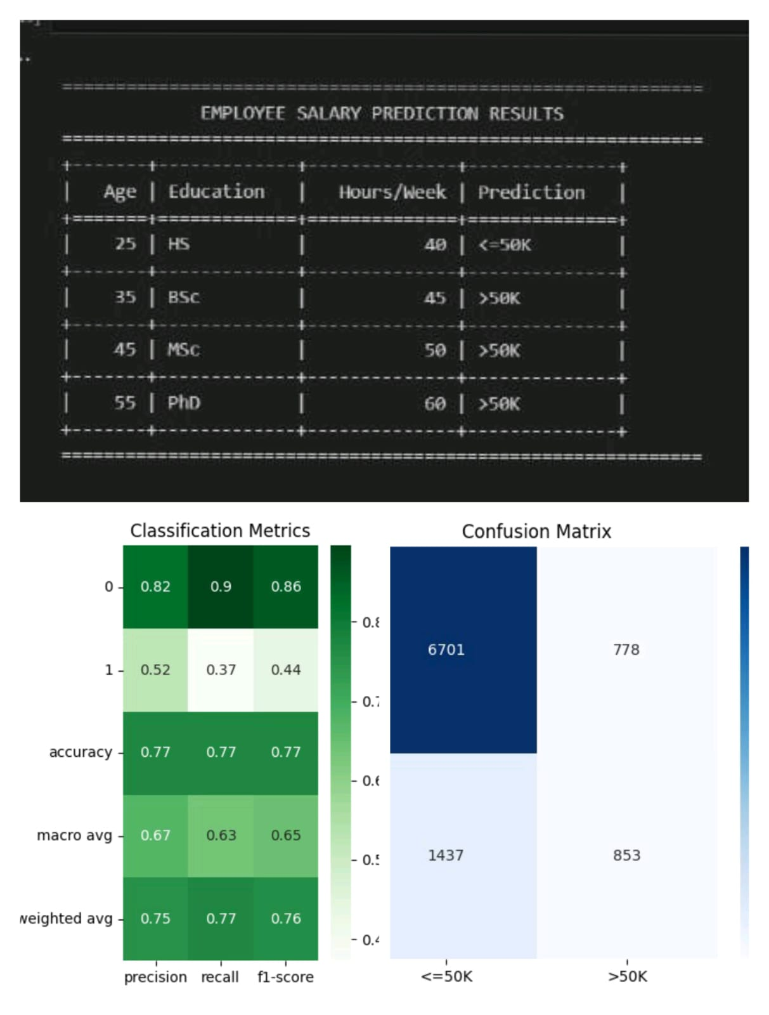
Result
Github Link:
https://github.com/parvathym155-coder/Parvathy-M/blob/main/README.md

Slide 7
Conclusion
This salary prediction model effectively classifies income brackets using a decision tree, achieving good accuracy with age, education and work hours as key predictors. The project delivered clear visualizations of model performance through confusion matrices and metrics, while highlighting challenges like data cleaning and feature limitations. Future enhancements could expand the feature set and employ more advanced algorithms to improve real-world applicability.

Slide 8
References
Google Colab: https://colab.research.google.com
Decision Trees: https://scikit-learn.org/stable/modules/tree.html
Confusion Matrix: https://scikit-learn.org/stable/modules/generated/sklearn.metrics.confusion_matrix.html
Train-Test Split: https://scikit-learn.org/stable/modules/generated/sklearn.model_selection.train_test_split.html

Slide 9
THANK YOU

